Slide 1
Closing the Digital Divide
XIV Cumbre de Reguladores y Operadores
REGULATEL - AHCIET
John Davies, VP Intel Corporation
Notes:
Fixed phone went personal with cellular
Believe the fixed Internet will follow the same path
In the short time today I want to discuss
The drivers of data demand and the need for BB wireless
What is Intel's vision for a 4G wireless broadband society
How real world WiMAX deployments are going today

Slide 2
Comparing to OECD
 | LAR | OECD
Broadband Penetration | < 10% | > 60%
BB as % of monthly income | ~ 10% | ~ 1%
Sources: WEF Global Information Technology Report 2009 – 2010 Report , EIU, ITU, IADB

Slide 3
2 Key Ways to Grow BB Penetration
Pre-Paid Broadband + Low-Cost PC
USF

Slide 4
Reaching First time Buyers
Lower Incomes limited by
1. Total Cost of Ownership
2. Contract Commitments
3rd Billion use prepaid phone
- 85% of users in Emerging markets

Slide 5
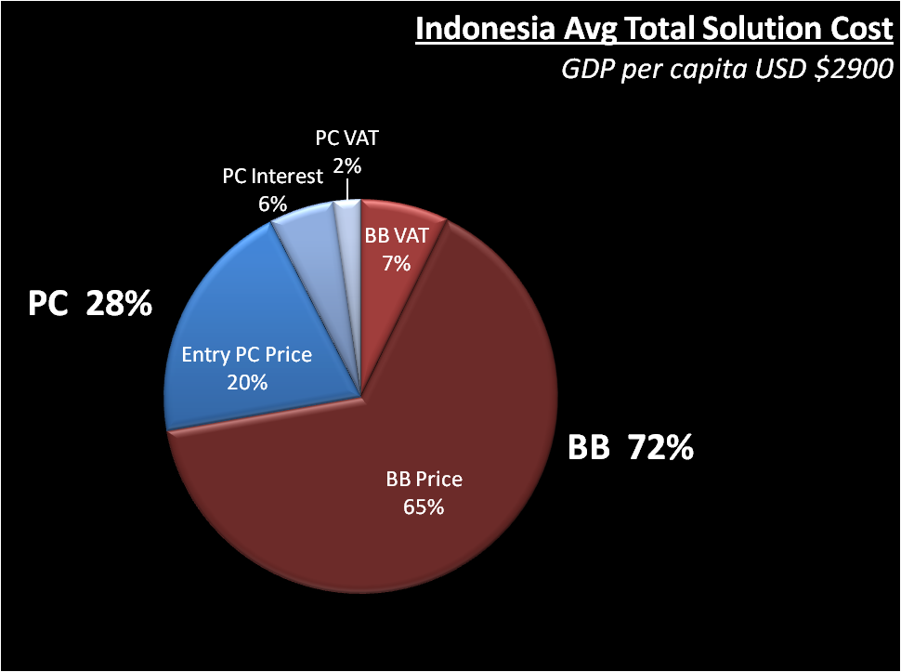
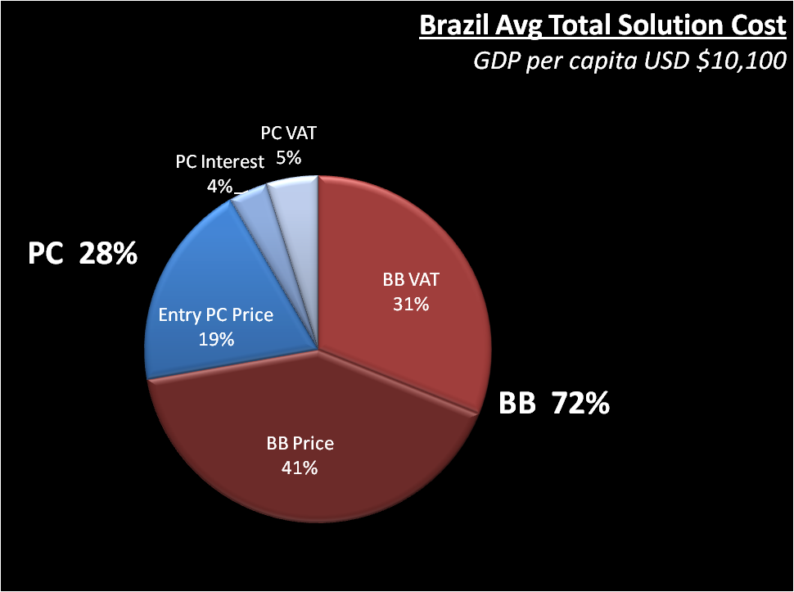
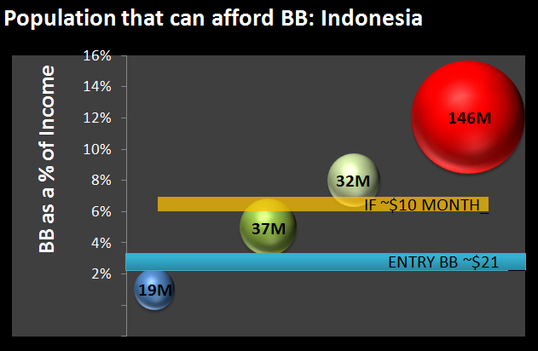
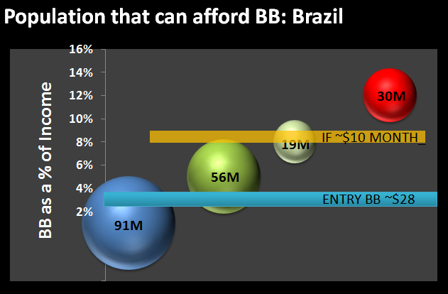
Reaching First Time Buyers– TCO of $350 PC + 4 years Broadband
ITU: BB <3% income affordable
Sources: Euro monitor, CIA Fact book, ITU, Intel BDMs

Slide 6
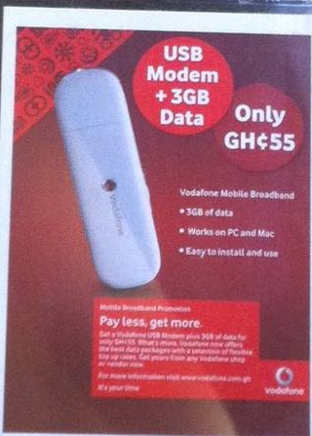
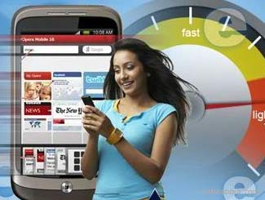
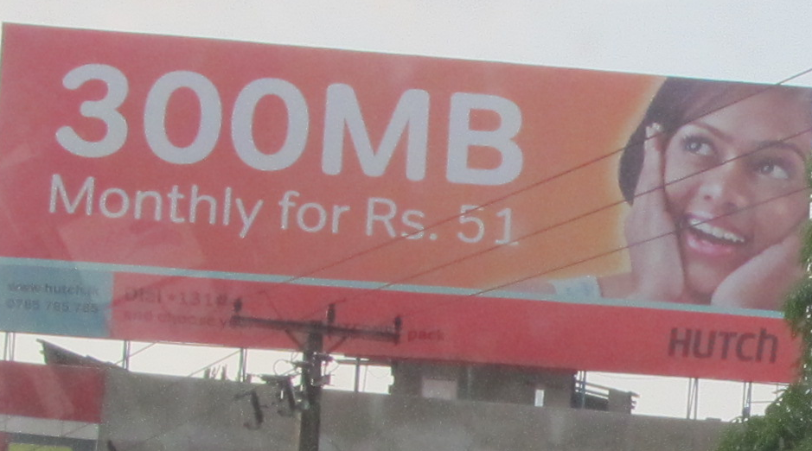
Low Cost Prepaid 3G Examples
Modem+ 3Gb ~$37, Ghana
3G ~$8/month India
3G ~$8/month Egypt
Entry 3G ~$0.40/300MbSri Lanka
3G ~$14/month Indonesia

Slide 7
Leading Uses of USF for Broadband
Country | Description
Turkey | 620,000 PC for teachers, BB to rural schools, Internet Centers,
Nigeria | Accelerate BB in Capitals, train educators, subsidize school PCs
Malaysia | Subsidize BB + PC to students and underserved population
Pakistan | BB Coverage – 100k to 1.5M BB subs in 2010, build out rural PC centers
Poland | Internet Tax Deduction - deduction of services fees up to ~$250/year
Morocco | Subsidize BB to schools & teachers
Romania | Build out of 600 telecenters
Vietnam | BB Coverage to villages & WiMAX pilots
*Portugal | Subsidize of Notebook s + 3G from spectrum auction
Colombia | BB Coverage to 4k public institutions with 4.7M people impacted
*Chile | BB Coverage - 90% coverage in rural areas
Ecuador | Subsidize BB to schools & teachers. Purchase 33k PCs for schools.
*Panama | Stimulus Funds ➔ Free Broadband Access (Wimax) to all citizens
$3B+ invested in last 3 years on ICT
programs impacting 320M+ people
Notes:
Chile
Increase BB coverage to +1474 rural communities, +90% of population with coverage, investment US$ 45 M
Coverage in rural areas grew from 34% to 70%
Additional programs to create competences in digital usage in SMB
Panama
Free Internet access in public areas: parks, public buildings.
Currently 33 cities with 1200 areas covered, 2011 another 33 cities with +1000 areas and 2014 all geography with more than 4000 points
Strong effort in e-government to avoid papers and a program to give PC to students.
Ecuador
Internet access to schools
Purchase of 33K PCs

Slide 8
Summary
Broadband ➔ Increased GDP + Benefits to people
Can quickly boost LAR Broadband penetration by.....
1. Prepaid Broadband + low cost PC
2. USF to reach rural + underserved areas
Private –Public partnerships can make it happen

